Slide 1

CS 449 Rec
Malloc lab + thread lab

Slide 2
Announcements
Malloc lab due on Nov. 29
Last lab: thread lab
I’ll have office hour next week
Either a recorded video or a detailed explanation will be posted for the practice final next week

Slide 3
Schedule
Quiz
More about evaluation
Gdb
Heap checker
Thread lab

Slide 4
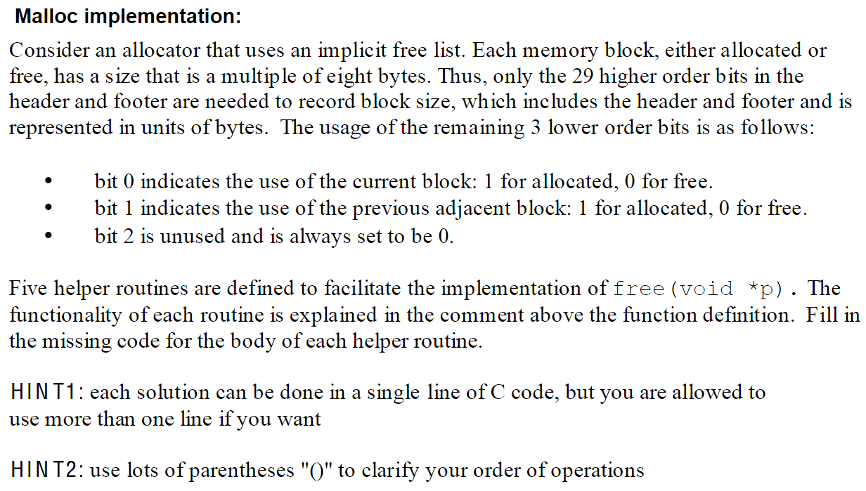
Quiz

Slide 5
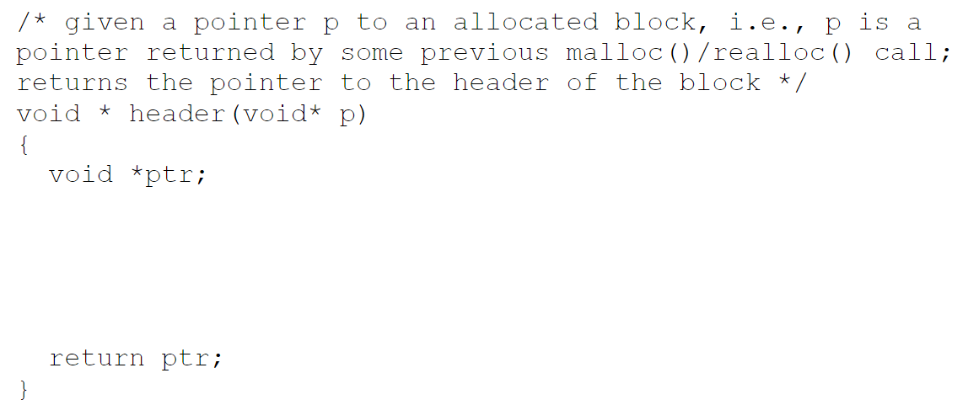
1

Slide 6
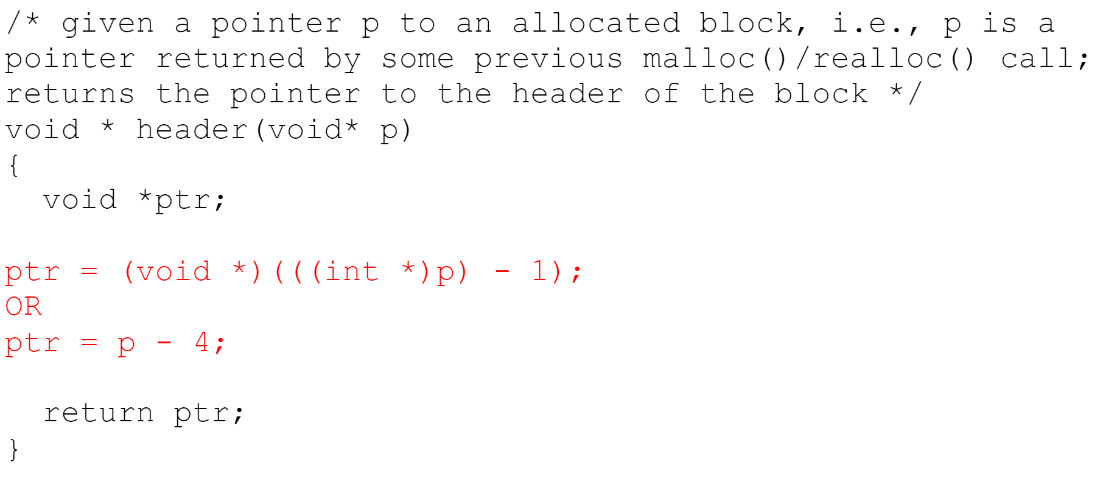
Answer

Slide 7
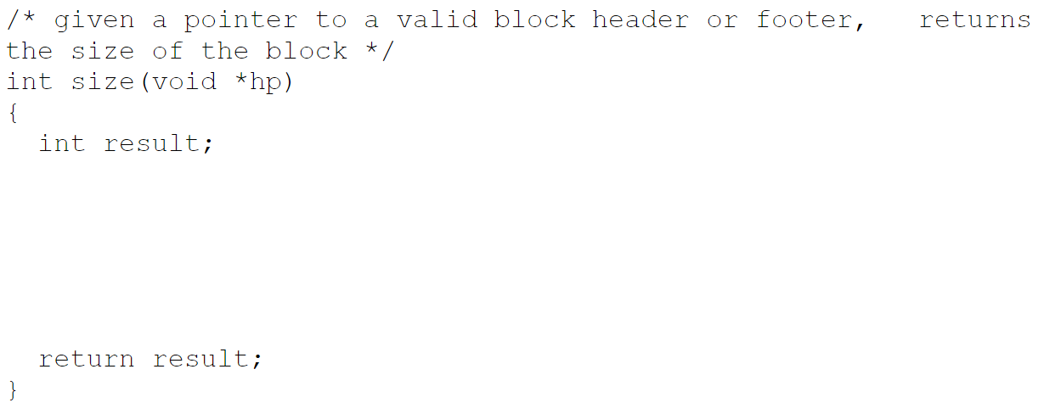
2

Slide 8
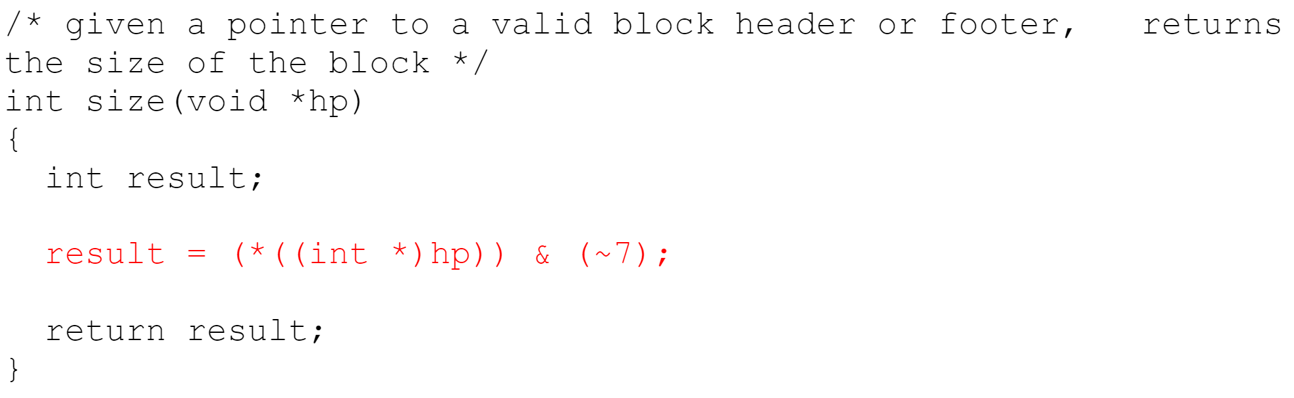
Answer

Slide 9
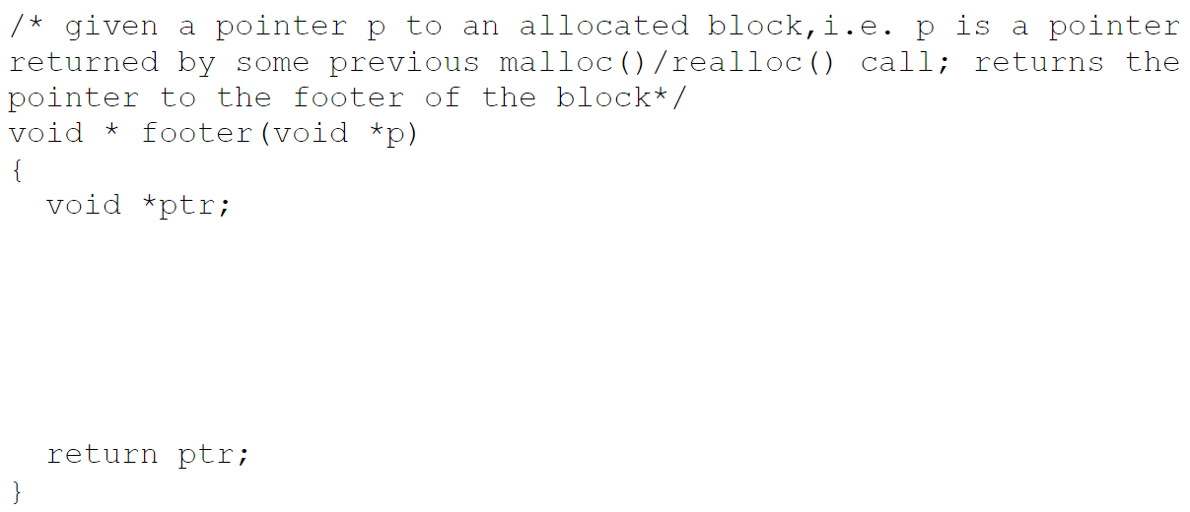
3

Slide 10
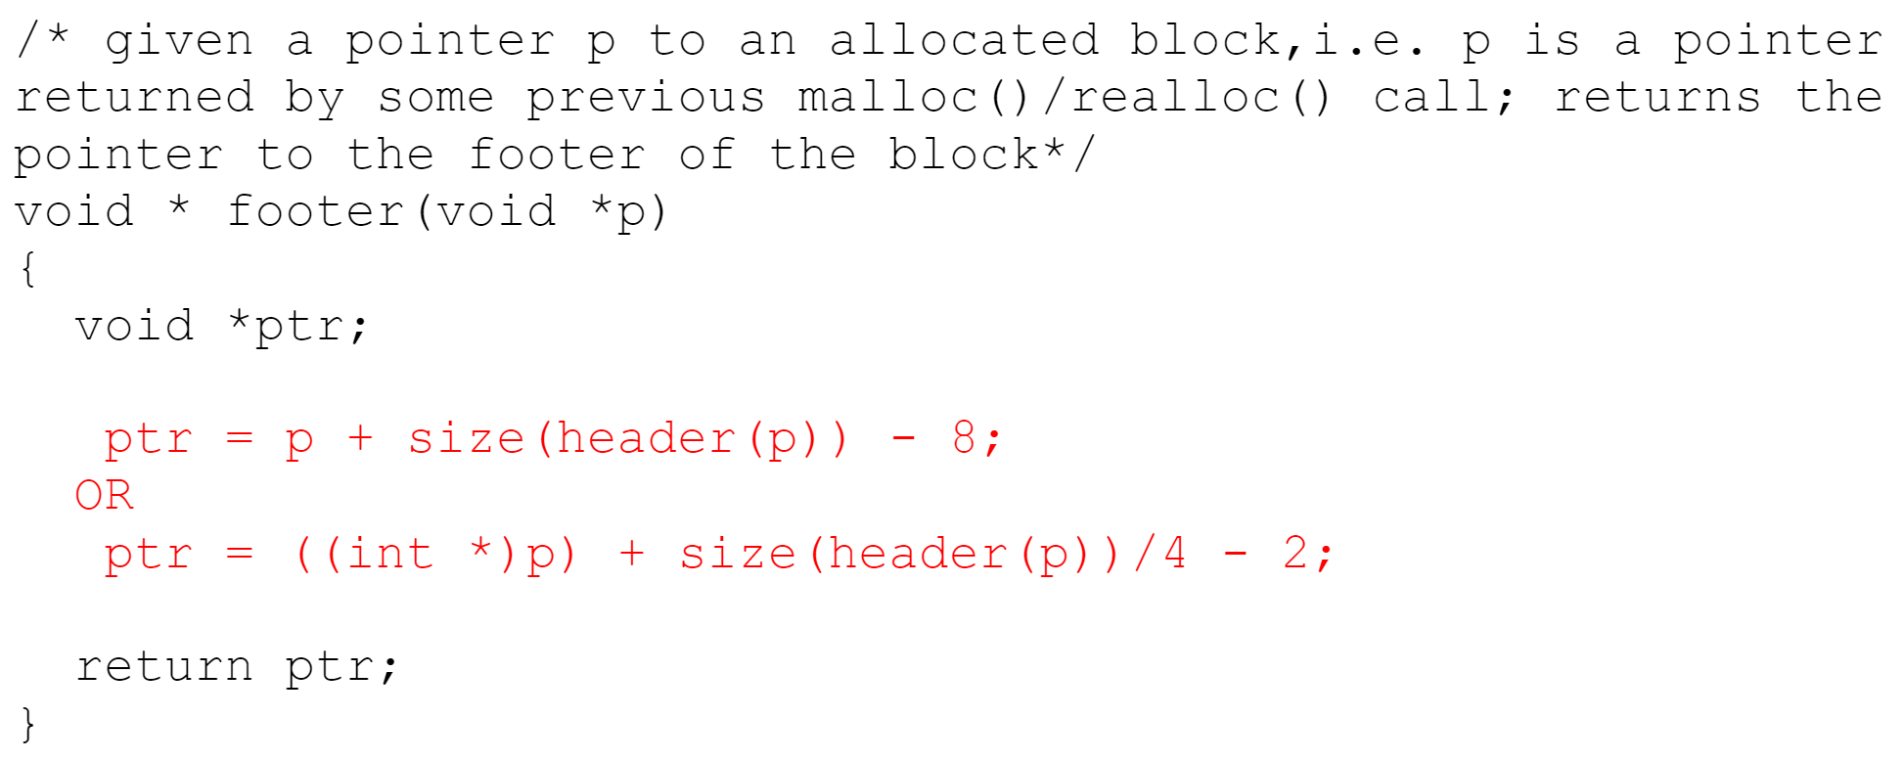
Answer

Slide 11
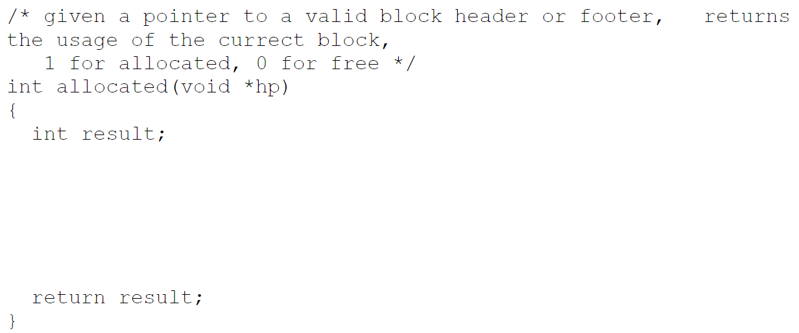
4

Slide 12
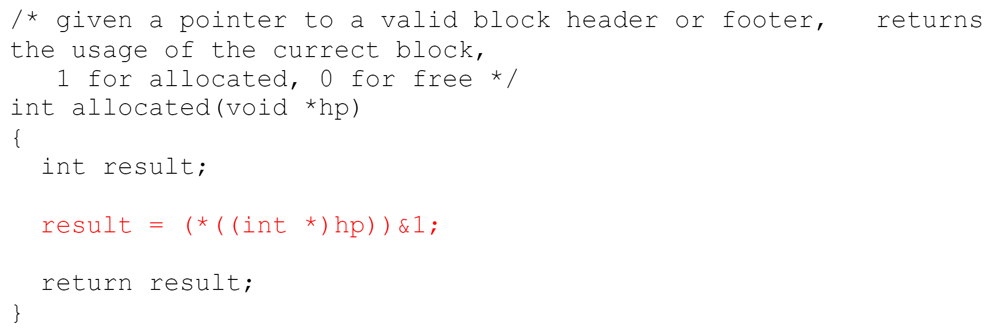
Answer

Slide 13
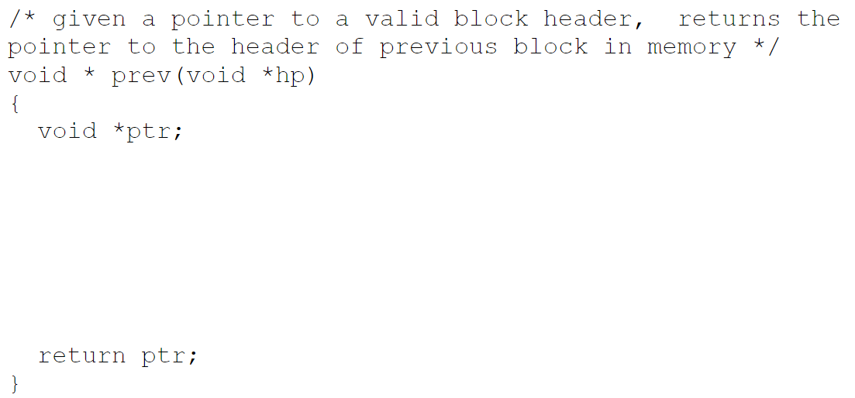
5

Slide 14
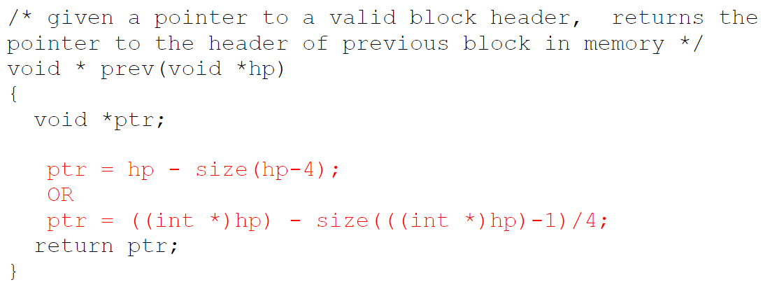
Answer

Slide 15
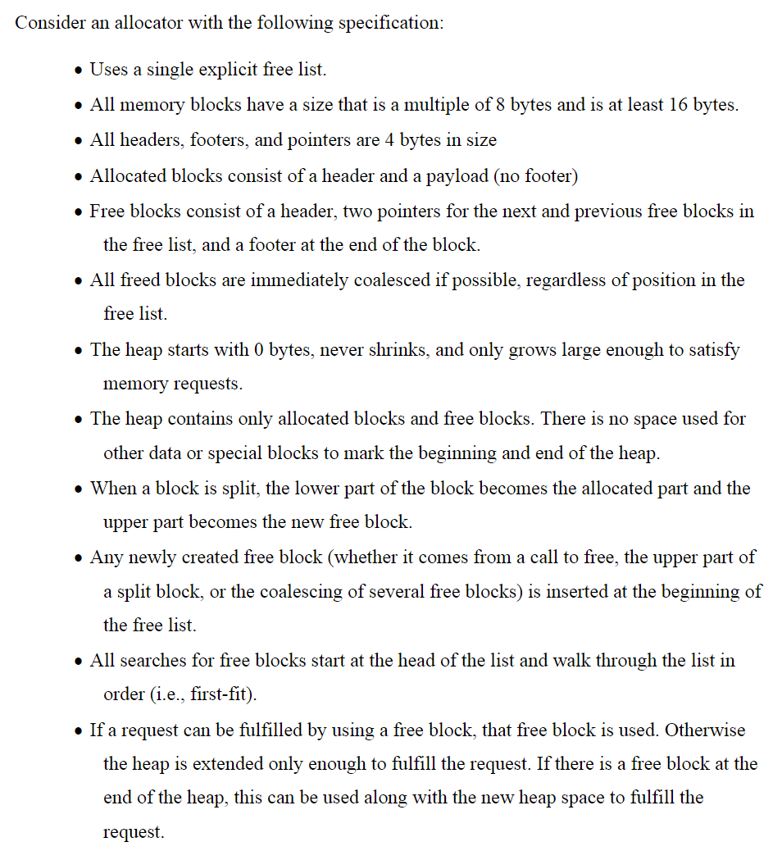
Dynamic memory allocator

Slide 16
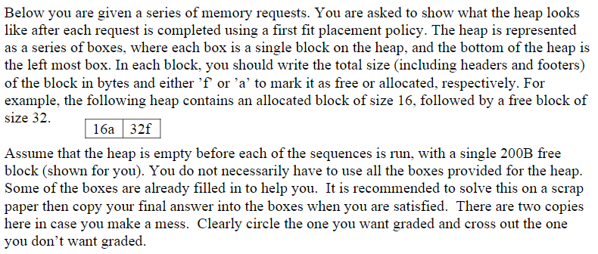
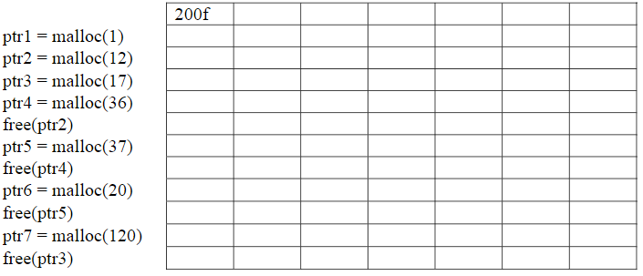
Quiz

Slide 17
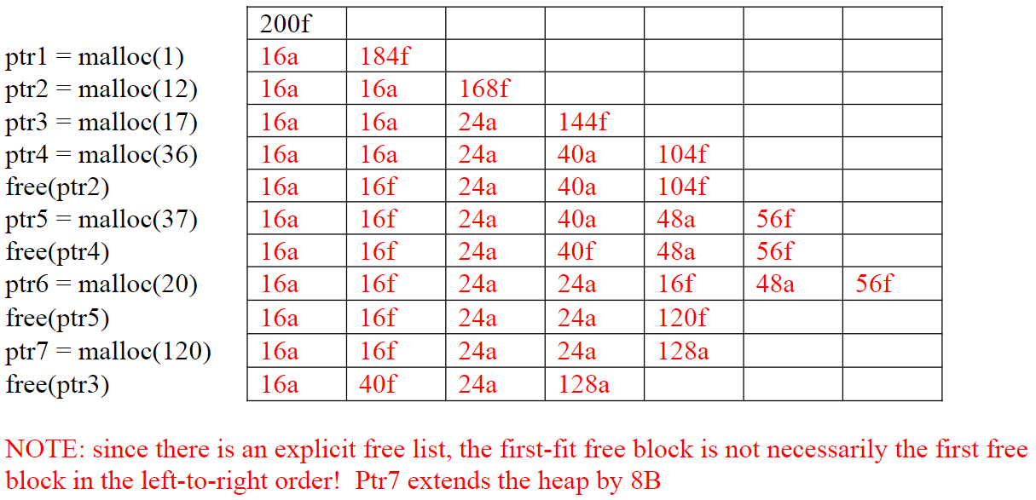
Answer

Slide 18
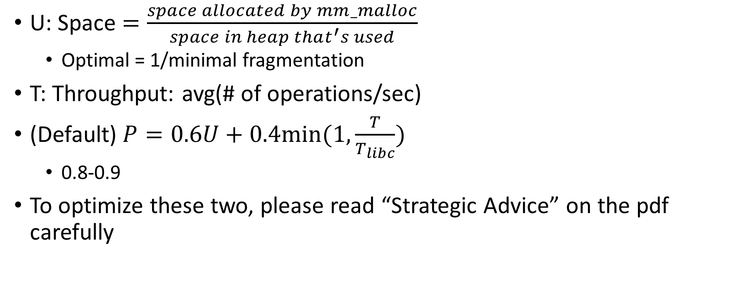
Performance metrics
U: Space $=\frac{space allocated by mm_malloc}{space in heap that^{′}s used}$
Optimal = 1/minimal fragmentation
T: Throughput: avg(# of operations/sec)
(Default)$P=0.6U+0.4min⁡(1, \frac{T}{T_{libc}})$
0.8-0.9
To optimize these two, please read “Strategic Advice” on the pdf carefully

Slide 19
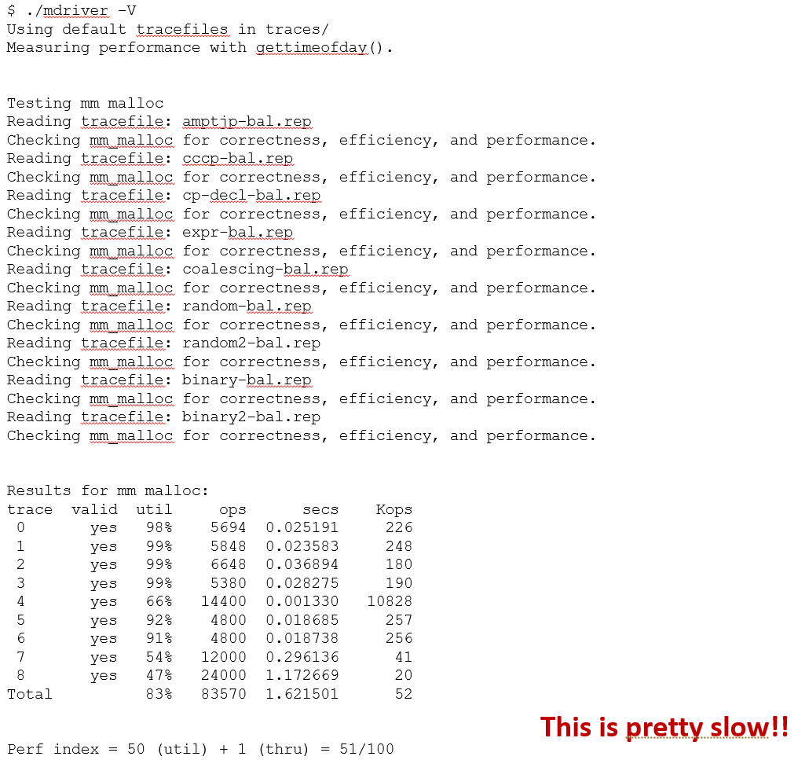

Slide 20
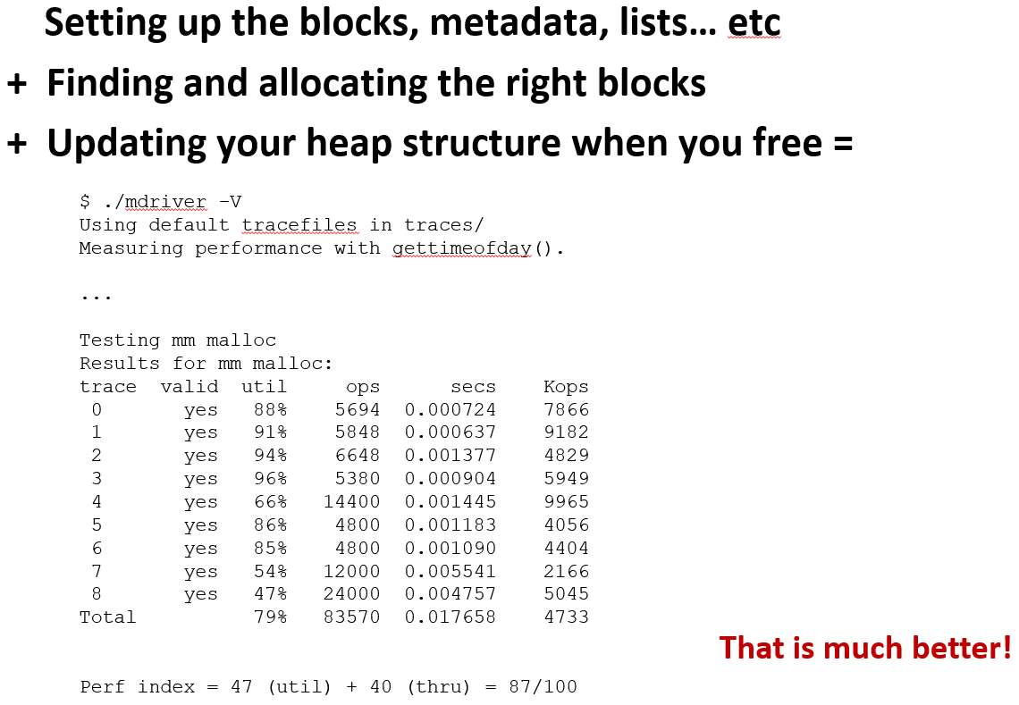

Slide 21
gdb
wget http://bit.ly/2CUCAsR -O malloclab-buggy.zip
unzip malloclab-buggy.zip
cd malloclab-buggy
make
gdb --args ./mdriver -f traces/binary-bal.rep
(gdb) run
(gdb) backtrace
(gdb) list

Slide 22
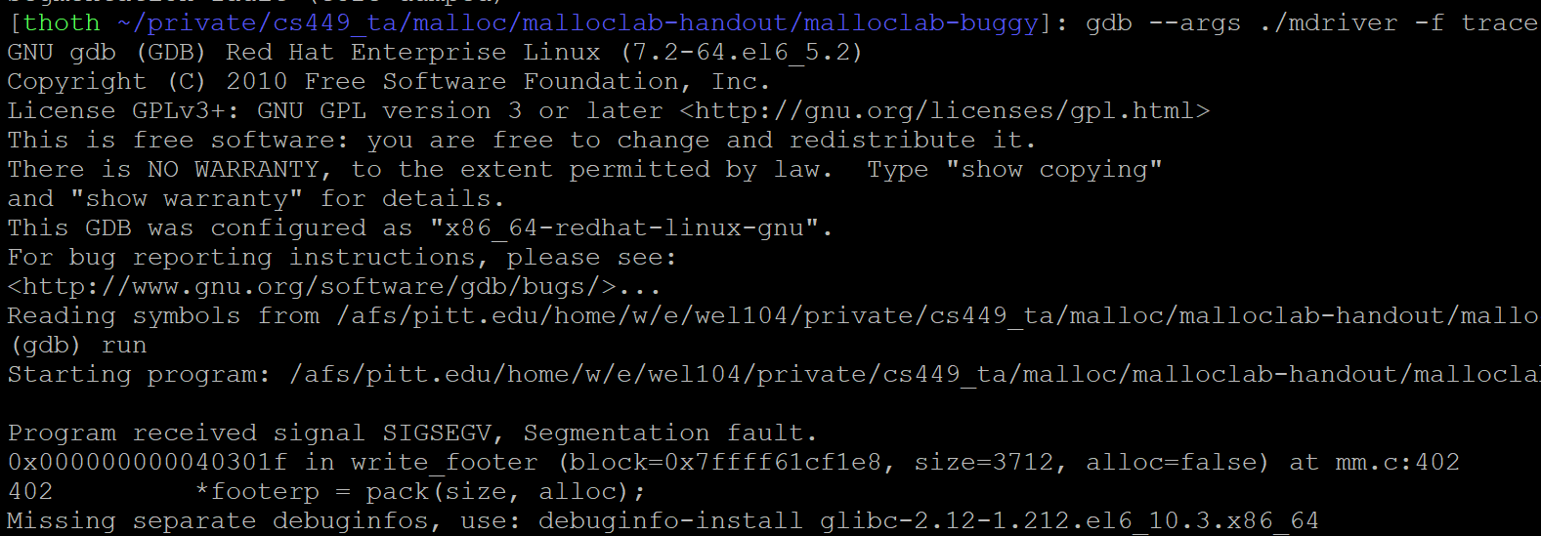
What caused the crash?

Slide 23
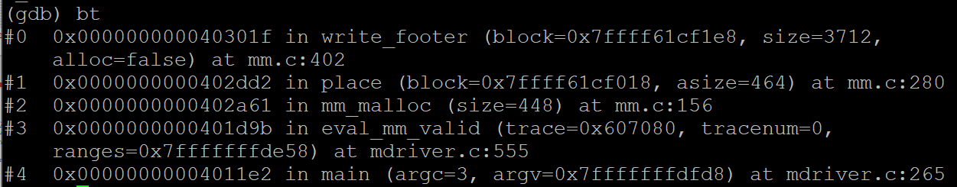
What function is listed on the top of backtrace (bt)?

Slide 24
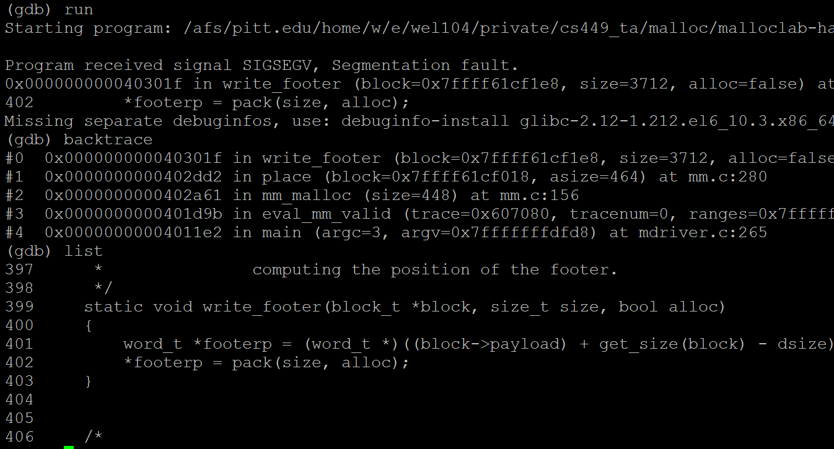
Looking for header

Slide 25
(cont.)
(gdb) break 402
(gdb) r
(gdb) x /10gx block
(gdb) frame 1
(gdb) list
(gdb) list place
…

Slide 26
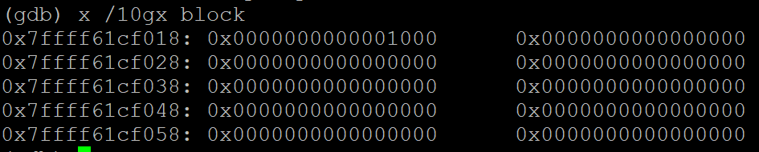
x /10gx block shows the memory contents within the block
Garbage value!
Header

Slide 27
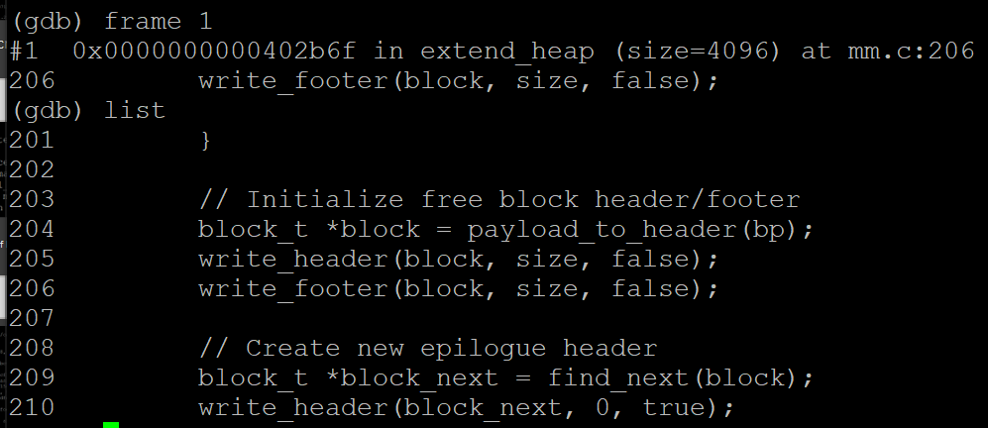
Jumps down one level (who called the function)

Slide 28
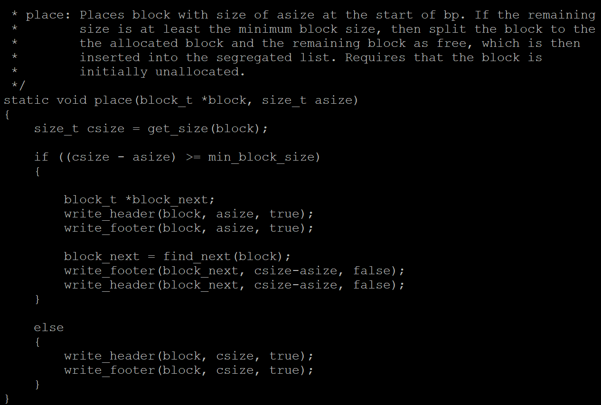
Place() splits it into block & block_next

Slide 29
Conclusion
It’s writing to block_next (new block created after split)
The header would be in the middle of the original free block
Write a new header before writing to footer
Dealing with segfault
Find the earliest time things went wrong
Print the whole heap before/after relevant functions
Heap checker!

Slide 30
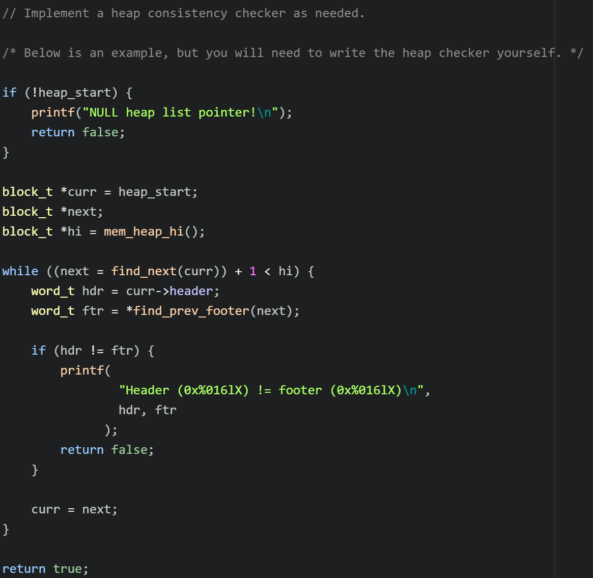
check_heap()

Slide 31
Invariants
Heap level
All blocks stay in between the heap boundaries (where the pointers point to)
Check coalescing: no two consecutive free blocks in the heap
List level
prev/next allocate/free bit consistency (if A’s next pointer points to B, B’s prev pointer should point to A)
Free list contains no allocated blocks
All free blocks are in the free list (Count free blocks by iterating through every block and traversing free list by pointers and see if they match)
Block level
Check epilogue and prologue blocks
Check block’s address alignment
Check each block’s header and footer: size (minimum size, alignment), header and footer matching each other
…(Add your own)

Slide 32
Concurrent programming
POSIX thread: P39-P41
Thread-based concurrency: P31-end

